Slide 1



UNIVERSITI TEKNOLOGI MALAYSIA
QUALIFYING ASSESSMENT CORRECTION
ENHANCED NEURAL MACHINE TRANSLATION FOR MALAY-ENGLISH CODE-SWITCHED TEXT
WONG YIT KHEE (PCS223010)
Supervised by:
Dr Sharin Hazlin binti Huspi
Dr Haslina binti Hashim
UTM JOHOR BAHRU

Slide 2


Introduction
Suitable for all categories business and personal presentation farmers ensure that we will bring

Slide 3





INTRODUCTION
INTRODUCTION
1

Slide 4


INTRODUCTION
INTRODUCTION
1

Slide 5
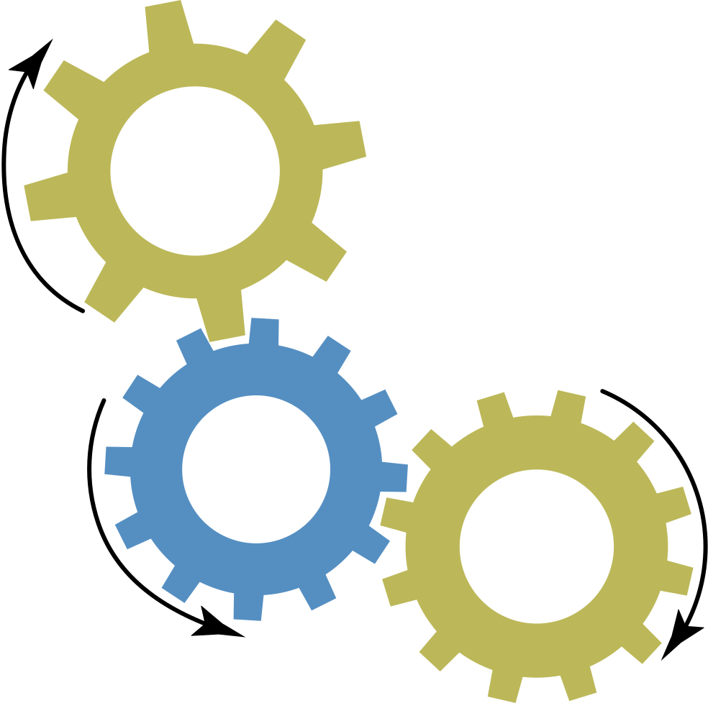
INTRODUCTION
INTRODUCTION
1

Slide 6

INTRODUCTION
Knowledge Discovery
INTRODUCTION
Data Mining
vital information
1

Slide 7
Code-
switching
INTRODUCTION
Knowledge Discovery
PROBLEM BACKGROUND
Data Mining
1

Slide 8






CODE-SWITCHING
A common situation found in semi-formal and casual events.
We apply dua bahasa in one sentence.
PROBLEM BACKGROUND
Morpheme counts decide the main language.
2
Notes:
For the translation-based text mining approach, To extract useful information from code-switched text data, we should first translate the text into monolingual. next can be sentiment analysis or else information mining process.
Here, we focus on Malay-English code-switching situation.

Slide 9


TRANSLATING MALAY-ENGLISH CS TEXT
Malay: low-resource data
Language Ambiguity
PROBLEM BACKGROUND
MT design for monolingual input
Scarcity of parallel dataset
Informal Language Usage
Structural Differences in Language
3

Slide 10

PROBLEM STATEMENT
The scarcity and quality of parallel corpus for Malay-English code-switched texts significantly impact the quality of machine translation. This challenge is compounded by informal language usage, differences in language structure and grammar, and the presence of ambiguity in code-switched texts.
PROBLEM BACKGROUND
RQ1
RQ2
RQ3
How can we effectively identify the primary sources of ambiguity that emerge during language identification and translation processes in code-switched scenarios, and systematically categorize and structure the identified sources of ambiguity to enhance the effectiveness of the language identification and translation processes?
How can we detect and classify the distinctive linguistic features and patterns of code-switched segments within Malay-English code-switched text data?
How can a translation process be tailored and optimized to effectively address the unique characteristics of each type of code-switched segment, resulting in more accurate and contextually appropriate translations?
4

Slide 11
RESEARCH AIM
RO1
To identify and organize the ambiguity present during language identification and translation process
RESEARCH AIM
To proposed an effective identification method that identify potential code-switch segments from code-switch text data
RO2
RO3
To develop a translation process optimized for each type of code-switched segment
5

Slide 12





RESEARCH SCOPE
01. CODE-SWITCH
The research will focus on the translation of Malay-English code-switch text
05. EVALUATION
The effectiveness of the translated text is evaluated by performance metrics review, baseline model comparison and crowd-sourcing evaluation
01
02
RESEARCH SCOPE
02. MALAY-ENGLISH
The language of the question will be in Malay-English mixed mode
05
SCOPE
04. PYTHON 3.0
The pre-process process and proposed model will be developed in Python language
03
04
03. DATA SOURCE
The code-switched dataset will be collected from the online health question-and-answering forum, DoctorOnCall, which consists of over 170 general diseases
6

Slide 13
EXPECTED CONTRIBUTION
Code-Switching Identification Innovation
addressing language ambiguity and improving translation accuracy
EXPECTED CONTRIBUTION
Linguistic Resources
Three-Phase Framework
7

Slide 14
Literature Review

Slide 15
CODE-SWITCHING (CS) TYPES
Inter-sentential CS
vs
Intra-sentential CS
Calques
CODE-SWITCHING
Intra-word CS
8
Notes:
For the translation-based text mining approach, To extract useful information from code-switched text data, we should first translate the text into monolingual. next can be sentiment analysis or else information mining process.
Here, we focus on Malay-English code-switching situation.

Slide 16
CODE-SWITCHING (CS) TYPES
Saya pergi ke kedai, tetapi terlupa dompet di rumah.
Inter-sentential CS
vs
Intra-sentential CS
CODE-SWITCHING
Intra-word CS
8
Notes:
For the translation-based text mining approach, To extract useful information from code-switched text data, we should first translate the text into monolingual. next can be sentiment analysis or else information mining process.
Here, we focus on Malay-English code-switching situation.

Slide 17
CODE-SWITCHING (CS) TYPES
Inter-sentential CS
vs
Intra-sentential CS
Calques
CODE-SWITCHING
Intra-word CS
8
Notes:
For the translation-based text mining approach, To extract useful information from code-switched text data, we should first translate the text into monolingual. next can be sentiment analysis or else information mining process.
Here, we focus on Malay-English code-switching situation.

Slide 18
CODE-SWITCHING (CS) TYPES
Inter-sentential CS:
Saya nak pergi ke kedai serbaneka [Malay structure], but forget my wallet at home [English structure].
Intra-sentential CS:
I pesakit covid 19 and family sy buat swab test, tiada simptom demam, adakah mereka akan negative?
Inter-sentential CS
vs
Intra-sentential CS
Calques
CODE-SWITCHING
Intra-word CS
8
Notes:
For the translation-based text mining approach, To extract useful information from code-switched text data, we should first translate the text into monolingual. next can be sentiment analysis or else information mining process.
Here, we focus on Malay-English code-switching situation.

Slide 19
CODE-SWITCHING (CS) TYPES
Inter-sentential CS
vs
Intra-sentential CS
Calques
CODE-SWITCHING
Intra-word CS
8
Notes:
For the translation-based text mining approach, To extract useful information from code-switched text data, we should first translate the text into monolingual. next can be sentiment analysis or else information mining process.
Here, we focus on Malay-English code-switching situation.

Slide 20
CODE-SWITCHING (CS) TYPES
Inter-sentential CS
vs
Intra-sentential CS
Calques
CODE-SWITCHING
Jobnya
8
Notes:
For the translation-based text mining approach, To extract useful information from code-switched text data, we should first translate the text into monolingual. next can be sentiment analysis or else information mining process.
Here, we focus on Malay-English code-switching situation.

Slide 21

MALAY & ENGLISH LANGUAGE STRUCTURE
Terms: expresses the time frame
‘telah’ for past event, ‘sedang’ for present event and ‘akan’ for future event
Unique Tenses: indicate the time frame
adding suffixes to alter the verb into the form of present, past, past present and future tenses
M
E
LANGUAGE DIFFERENCE
Plurality of nouns
use a duplicated form (kanak-kanak) or add quantifiers words like ‘banyak’ (many) or the direct amount to the target noun.
Plurality of nouns
adding ‘s’ or ‘ies’ or ‘es’ to indicate more than one object existed.
M
E
9

Slide 22
MALAY & ENGLISH LANGUAGE STRUCTURE
Affixes Usage:
indicate the part of speech of the target word
A ‘ke-’ prefix with ‘-an’ suffix often attached to a noun verb
Affixes Usage:
suffix indicate or change the part of tenses or plurality
prefix like ‘un’ give an opposite meaning to the root word
M
E
LANGUAGE DIFFERENCE
9

Slide 23




















Translating Text Data
Rule-based Machine Translation
Defining and programming these rules are complex and need to be done manually, pretraining the machine is, therefore, a challenging process
Neural Machine Translation
Neural networks excel at semantic and syntactic understanding during translation without requiring hard source segmentation. They are, however, data size-dependent
Human Translation
Costly and time-consuming for large data volume
TRANSLATION PROCESS
1949
1960
1980
2014
Dictionary-based Machine Translation
Due to the issue of the very indifferent structure of each language discussed, the resulting translation back then was very poor
Statistical Machine Translation
This machine translation model required a massive volume of training data for a great-performing translation model
10
Notes:
coverts the source text into targeted language while ensuring the preservation of the original meaning and fluency of the translated text.

Slide 24

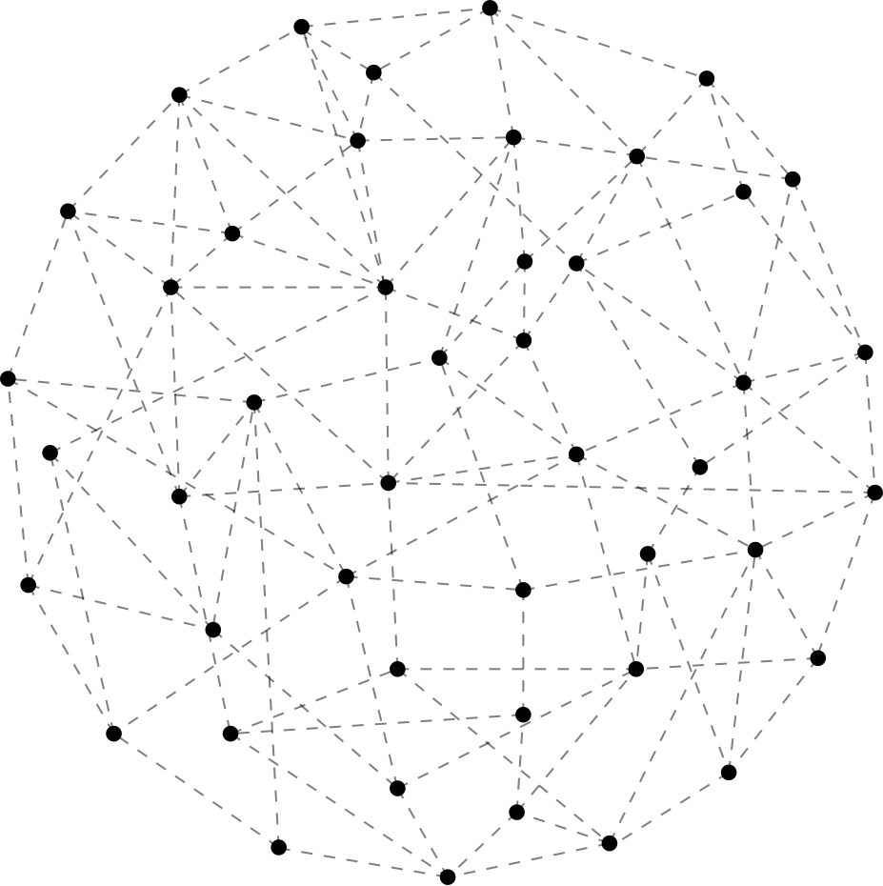
NEURAL MACHINE TRANSLATION (NMT)
Semantic and syntactic captures
Translate without hard segmented the source part
highly accurate
highly flexible
TRANSLATION PROCESS
fast learning
Data-size dependent
11
Notes:
coverts the source text into targeted language while ensuring the preservation of the original meaning and fluency of the translated text.

Slide 25
What do we found?
CS: lack of sufficient parallel CS dataset
MT: complexity of text data (with time dimension)
CHALLENGES
CS: Malay language: low resource language
MT: lack of a unified approach to handling code-switching
CS: Informality & Ambiguity
MT: very little research is done to Malay-English CS text data
12
Notes:
coverts the source text into targeted language while ensuring the preservation of the original meaning and fluency of the translated text.

Slide 26
What do we learn from previous research?
Language Identification process aids CS Translation
Translate only the needed part increase accuracy
DISCUSSION
13
Notes:
coverts the source text into targeted language while ensuring the preservation of the original meaning and fluency of the translated text.

Slide 27
Research Methodology

Slide 28
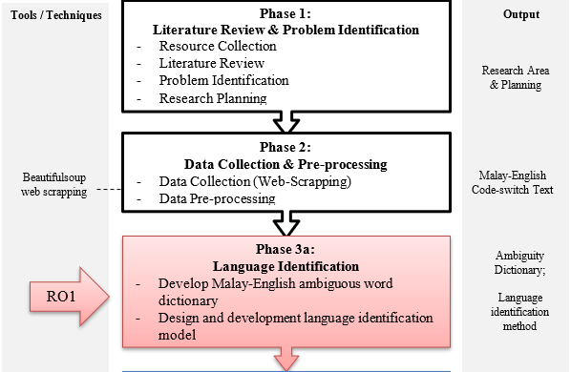
RESEARCH FRAMEWORK
14
Notes:
coverts the source text into targeted language while ensuring the preservation of the original meaning and fluency of the translated text.

Slide 29
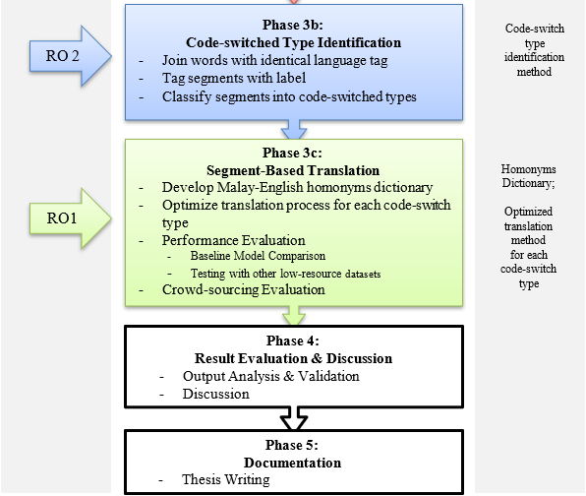
RESEARCH FRAMEWORK
14
Notes:
coverts the source text into targeted language while ensuring the preservation of the original meaning and fluency of the translated text.

Slide 30

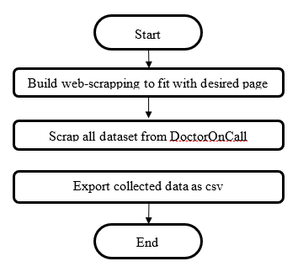


Data Source
too formal
DATA COLLECTION
too short
too wide
15
Notes:
coverts the source text into targeted language while ensuring the preservation of the original meaning and fluency of the translated text.

Slide 31


Data Source
Focus on GP domain
Easiy access data
DATA COLLECTION
CS situation is observed
Scrapping-friendly website design
15
Notes:
coverts the source text into targeted language while ensuring the preservation of the original meaning and fluency of the translated text.

Slide 32
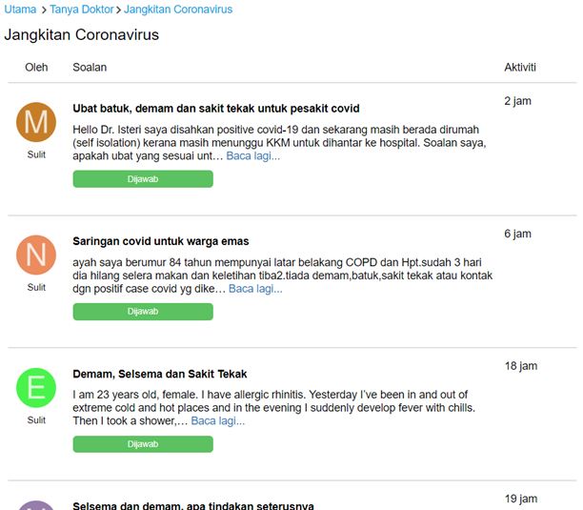
Data Source
DATA COLLECTION
15
Notes:
coverts the source text into targeted language while ensuring the preservation of the original meaning and fluency of the translated text.

Slide 33

Web-scrapping tool
Ease of Use
Robust Parsing
DATA COLLECTION
Rich Features
Widely Adopted
171 disease categories; 52970 queries [retrieved on Aug 2023]
15
Notes:
Ease of Use: BeautifulSoup provides a user-friendly and intuitive way to parse HTML and XML documents. Its simple syntax makes web scraping more accessible, even for those without extensive programming experience.
Robust Parsing: It's capable of handling poorly formatted HTML, which is common on the web. BeautifulSoup can navigate and extract data from complex web pages without breaking.
Rich Features: BeautifulSoup offers a range of methods for searching and manipulating parsed data, making it versatile for a wide variety of web scraping tasks. You can extract specific elements, filter data, and traverse the document structure efficiently.
Widely Adopted: BeautifulSoup is a widely used library in the Python web scraping community, meaning there's a wealth of resources and documentation available. This makes it easier to find help, tutorials, and examples when working on web scraping projects.

Slide 34
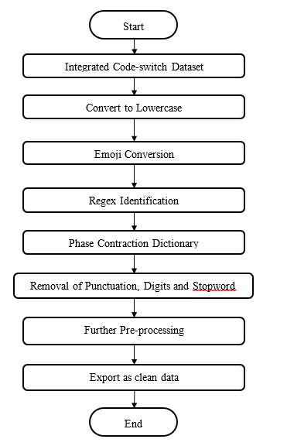
REGEX Modification
using regular expressions to remove repetitions of letters in tokens.
Gooooooooood
Good
DATA PREPROCESSING
Phrase Contraction
map unusual words or contractions to their more standard forms
sry
sorry
16
Notes:
Ease of Use: BeautifulSoup provides a user-friendly and intuitive way to parse HTML and XML documents. Its simple syntax makes web scraping more accessible, even for those without extensive programming experience.
Robust Parsing: It's capable of handling poorly formatted HTML, which is common on the web. BeautifulSoup can navigate and extract data from complex web pages without breaking.
Rich Features: BeautifulSoup offers a range of methods for searching and manipulating parsed data, making it versatile for a wide variety of web scraping tasks. You can extract specific elements, filter data, and traverse the document structure efficiently.
Widely Adopted: BeautifulSoup is a widely used library in the Python web scraping community, meaning there's a wealth of resources and documentation available. This makes it easier to find help, tutorials, and examples when working on web scraping projects.

Slide 35
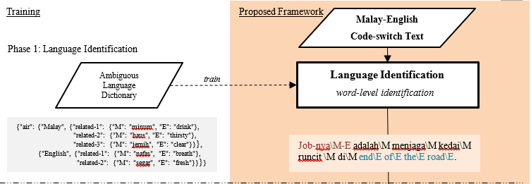
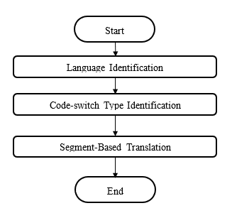
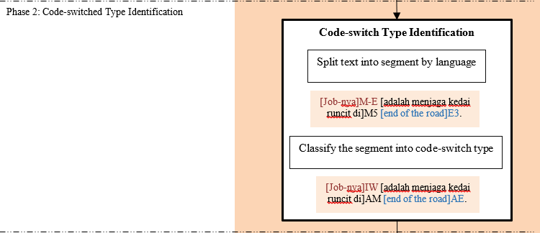
PROPOSED FRAMEWORK
17
Notes:
coverts the source text into targeted language while ensuring the preservation of the original meaning and fluency of the translated text.
The dictionary is ongoing, with version, what to add on each meeting

Slide 36
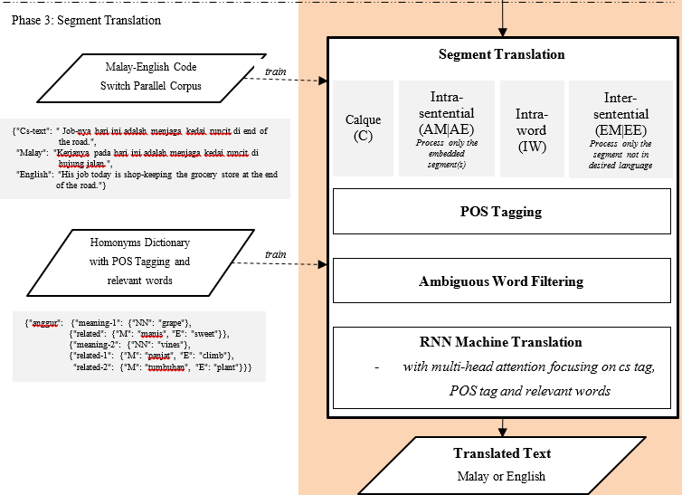
PROPOSED FRAMEWORK
17
Notes:
coverts the source text into targeted language while ensuring the preservation of the original meaning and fluency of the translated text.

Slide 37
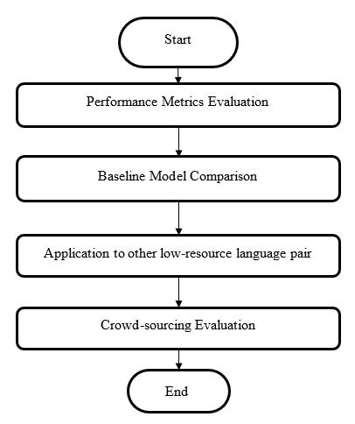
Performance Metrics
BLEU Score
WER rate
assesses the n-gram similarity of machine-translated text to a set of reference translations
calculates the percentage of words in the machine translation output that differ from the reference translation
PERFORMANCE EVALUATION
TER Score
METEOR Score
measures the edit distance between the machine translation output and the human reference translation
weighted combination of translation quality, including precision, recall, and alignment of words and phrases
18
Notes:
coverts the source text into targeted language while ensuring the preservation of the original meaning and fluency of the translated text.

Slide 38
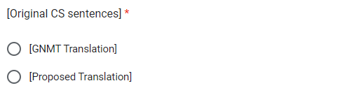
Baseline Model Comparison
BERT
GNMT
Crowd-sourcing Evaluation
Questionnaire
PERFORMANCE EVALUATION
Choose the translation based on their personal preference
18
Notes:
coverts the source text into targeted language while ensuring the preservation of the original meaning and fluency of the translated text.

Slide 39
Research Design
& Implementation

Slide 40
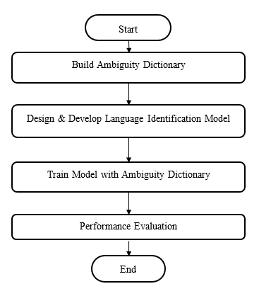
LANGUAGE IDENTIFICATION
Training
Expected
Ambiguity Dictionary
Language -tagged training data.
Job-nya adalah menjaga kedai runcit di end of the road.
CS sentences.
RESEARCH DESIGN
Language Identification Model
Trained Language Identification
Model
CS sentences with language tags.
CS sentences with language tags.
Job-nya\M-E adalah\M menjaga\M kedai\M runcit \M di\M end\E of\E the\E road\E.
19

Slide 41
LANGUAGE IDENTIFICATION
Training
Expected
Ambiguity Dictionary
Labelled training data.
Job-nya adalah menjaga kedai runcit di end of the road.
CS sentences.
RESEARCH DESIGN
Language Identification Model
Trained Language Identification
Model
CS sentences with language tags.
CS sentences with language tags.
Job-nya\M-E adalah\M menjaga\M kedai\M runcit \M di\M end\E of\E the\E road\E.
20

Slide 42
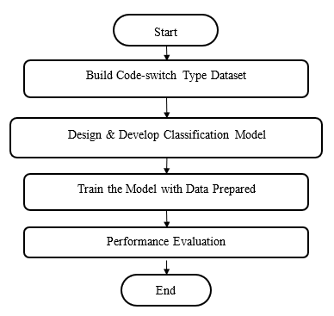
CS TYPE IDENTIFICATION
Training
Expected
Labelled CS data.
Job-nya\M-E adalah\M menjaga\M kedai\M runcit \M di\M end\E of\E the\E road\E.
CS Type Identification Model
CS sentences with language tags.
RESEARCH DESIGN
Split text into segment by language
Trained CS Type Identification
Model
Classify the segment into code-switch type
CS sentences with CS-type tags.
CS sentences with CS-type tags.
[Job-nya]IW [adalah menjaga kedai runcit di]AM [end of the road]AE.
21

Slide 43
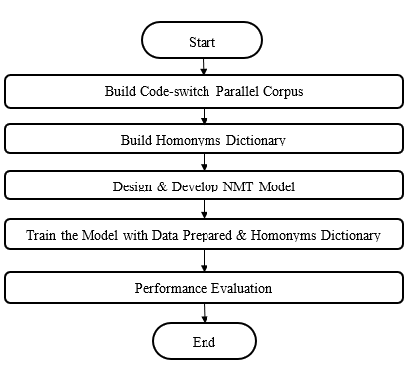
SEGMENT-BASED TRANSLATION
Training
Expected
Homonyms Dictionary
CS sentences with CS-type tags.
[Job-nya]IW [adalah menjaga kedai runcit di]AM [end of the road]AE.
CS sentences with CS-type tags.
RESEARCH DESIGN
Trained Machine Translation Pipeline
Machine Translation Pipeline
Translate according to CS Type
Monolingual Translated Sentence
Monolingual Tranlslated Sentence
Kerjanya pada hari ini adalah menjaga kedai runcit di
hujung jalan
22

Slide 44


SEGMENT-BASED TRANSLATION
Sequential Input
Saya
mahu
attract
interest
...
<EOS>
RESEARCH DESIGN
Main language word(s) is supplied to assist the translation process
Saya
mahu
<SOS>
Saya
mahu
menarik
...
<EOS>
Sequential Output
23

Slide 45
CONCLUSION

Slide 46

RO1: to identify and organize the ambiguity present during language identification and translation process
ACHEIVEMENT OF OBJECTIVE
Literature reviews on past papers are done on language identification code-switch type identification and machine translation.
2. Language structure analysis and open-access Malay and English dictionary has been explored
24

Slide 47









Future works to be conducted for this research will emphasize the design and development process including
Malay-English Ambiguity Dictionary with related words
Explore the effect of homonyms dictionary to the performance of machine translation
FUTURE STEPS
Synth chartreuse XOXO, tacos brooklyn VHS plaid.
Hashtag fashion axe fingerstache brooklyn YOLO.
Synth chartreuse XOXO, tacos brooklyn VHS plaid.
Hashtag fashion axe fingerstache brooklyn YOLO.
Explore more about the structure and design of machine translation to improve the translation accuracy of code-switch text.
Explore the effect of ambiguity dictionary to the performance of language identification
Synth chartreuse XOXO, tacos brooklyn VHS plaid.
Hashtag fashion axe fingerstache brooklyn YOLO.
Apply the proposed solution to other code-switched language-pairs in order to further evaluate the solution
Explore more on code-switch type identification including the evaluating metrics and efficient algorithms
Homonyms Dictionary with POS tags and relevant words
25

Slide 48

ENHANCE TRANSLATION ACCURACY
LANGUAGE IDENTIFICATION
CONCLUSION
ADDRESSING LINGUISTIC NUANCES, INFORMAL LANGUAGE, STRUCTURAL DIFFERENCES
CODE-SWITCHING TYPE IDENTIFICATION
CS TEXT DATA
ADDRESSING AMBIGUITY IN CODE-SWITCHED TEXTS
SEGMENT TRANSLATION
26

Slide 49



THANK YOU
QUALIFYING ASSESSMENT
ENHANCED NEURAL MACHINE TRANSLATION FOR MALAY-ENGLISH CODE-SWITCHED TEXT
Kerana Tuhan untuk Manusia

